Slide 1


Federated Learning with Pretrained Text Deep Neural Networks
Sponsor: Google
Data Scientists: Arjun Singh, Joel Stremmel
https://design.google/library/evolving-google-identity/
https://www.amazon.com/University-Washington-Logo-Area-Rug/dp/B01LWRSAQL

Slide 2

Stack Overflow Data
Host: Kaggle
Owner: Stack Overflow
License: CC BY-SA 3.0
Access API: Tensorflow Federated Datasets
Image Source: https://images.app.goo.gl/VrkTzXGHXBdi2A6X9

Slide 3

Data Pipeline: Provenance
The tff.simulation.ClientData class
Holds a dataset and maps clients to examples for Federated SGD
Data is not brought into memory until training starts
Access a dataset from tff.simulation.datasets, i.e. tff.simulation.datasets.stackoverflow
https://en.wikipedia.org/wiki/TensorFlow

Slide 4
Data Pipeline: Attributes
Content: Body text of all Stack Overflow Questions and Answers (Updates Quarterly)
Metadata:
Creation date
Question title
Question tags
Question score
Type (Question or Answer)
Data Splits:
Train: Data before 2018-01-01 UTC except the held-out users. 342,477 unique users with 135,818,730 examples.
Held-out: All examples from users with user_id % 10 == 0 (all dates). 38,758 unique users with 16,491,230 examples.
Test: All examples after 2018-01-01 UTC except from held-out users. 204,088 unique users with 16,586,035 examples.
Slide Text Source: https://www.tensorflow.org/federated/api_docs/python/tff/simulation/datasets/stackoverflow/load_data

Slide 5
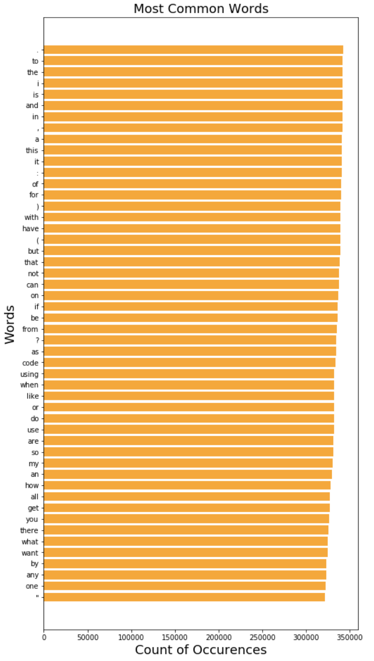
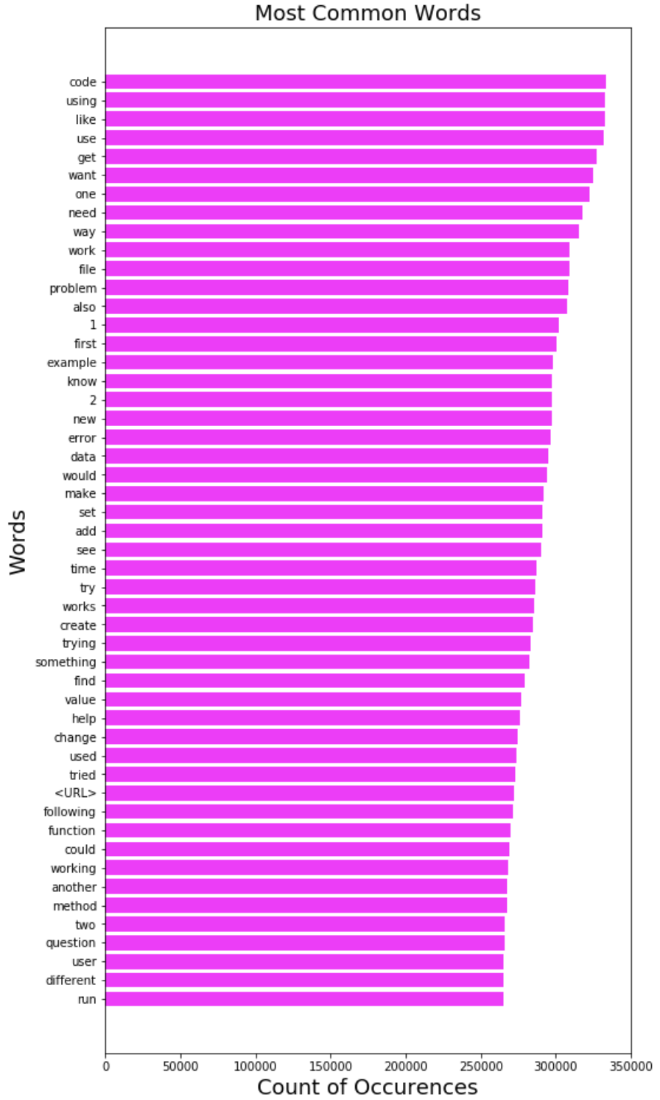
Exploratory Analysis: The Most Common Words Used on Stack Overflow
Before stopwords and punctuation filter.
After stopwords and punctuation filter.

Slide 6
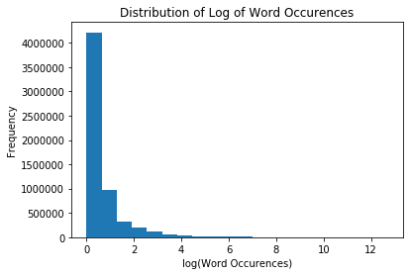
Distribution of Word Occurrences
The adjacent figure exhibits the distribution of (the logarithm) word occurrences with the frequency corresponding to those words in the entire Stackoverflow corpus

Slide 7
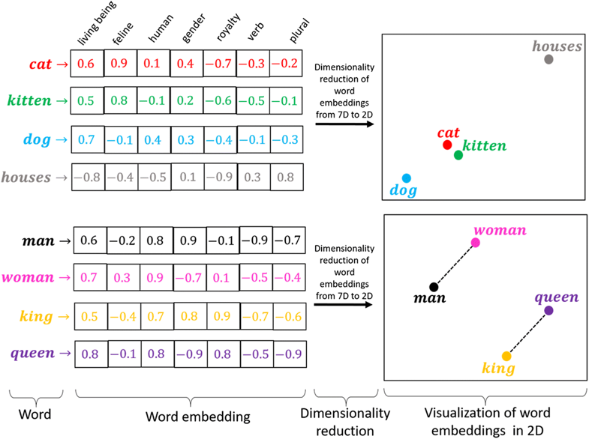
Features to be extracted
Since we’re mainly working with Natural Language Understanding, our features are text features
These could be word embedding, sentence embedding or even document embedding
We can leverage features pertaining to simpler approaches of language modeling, such as Bag of Words in the beginning and then proceed to more involved features
https://link.springer.com/article/10.1007/s12115-019-00362-9

Slide 8
Challenges
Since the dataset is hosted by Tensorflow Federated Datasets, most of the initial setup and cleaning related work is already done
The major challenge is to assess the NLP tasks that are well-suited for a technical dataset like StackOverflow

